Slide 1
PERSONAL FINANCING
Market Analysis and Campaigns
Notes:
1

Slide 2


Personal Financing (Risk Category: Market Risk: New & existing campaign)
 | AmMoney Line | Product Features
AmBank Promotion |  | Key Benefits : 5% yearly interest rebate for prompt paymaster. Flexi Loan Amount RM2K – RM100K Tenure 12 – 60 Months No processing fees Rate & Charges : Flat Profit rates : 8% - 11.99% p.a. depends on Loan Amount, Tenure, and Type of Employment.
 | Cash Plus Personal Loan
CIMB Promotion |  | Eligibility : Malaysian Citizen Individual Applicant, Age between 21- 58 years Min Gross Income : RM2,000 Employment more than 6 consecutive months Application Channel : Via Online Campaign Duration : 1st Nov 2017 - 31st Jan 2018 Rewards: RM100 Cash Back upon first installment.

Slide 3








Personal Financing Campaign Market Comparison
Bank / FI | Ringgit Plus | Features | Duration | Rewards
 | Ringgit plus promotions | Apply via Ringgitplus, Approved & disbursed FA > 20K | 5th Dec - 31st Jan 2018 | RM50 Petrol Voucher
 | Ringgit plus promotions | Apply via Ringgitplus, Approved & disbursed FA > 20K | 06th June’17 - 31st Jan’ 18 | RM100 Touch ’n Go Card
 | Ringgit plus promotions | Apply via Ringgitplus, FA:RM21K- RM150K Tenure 1 - 5yrs | 20 Dec 2017 - 31 Mar 2018 | RM200 / RM400 Giant Voucher
 | Ringgit plus promotions | Apply via Ringgitplus, FA:RM5K- RM150K.Tenure 2 - 5yrs | 17th July 2018 – 31st Jan 2018 | Philips Portable Speaker
 | Ringgit plus promotions | Apply via Ringgitplus, FA:RM4K- RM250K. Tenure 2 - 5yrs | 1st Aug 2017 - 24th Mar 2018 | Rates at 6.99% p.a. with complement RM50 Giant Gift Card
 | Ringgit plus promotions | Apply & disbursed for Min RM10K- RM150K, Tenure 2- 8 years. | 18th Sept’17 – 31st Mar 2018 | SONY 5000mAh Power Bank.
 | Ringgit plus promotions | Apply via Ringgitplus, FA: RM21K-RM150K. Tenure 1 – 7 years | 20th Dec 2017 - 30th Apr 2018. | RM200 / RM400 Giant Voucher
 | Ringgit plus promotions | Apply via Ringgitplus, FA: RM5K-RM250K. Tenure up to 10 years | 10th Oct 2017 – 10 Oct 2018 | RM50 Giant Voucher

Slide 4

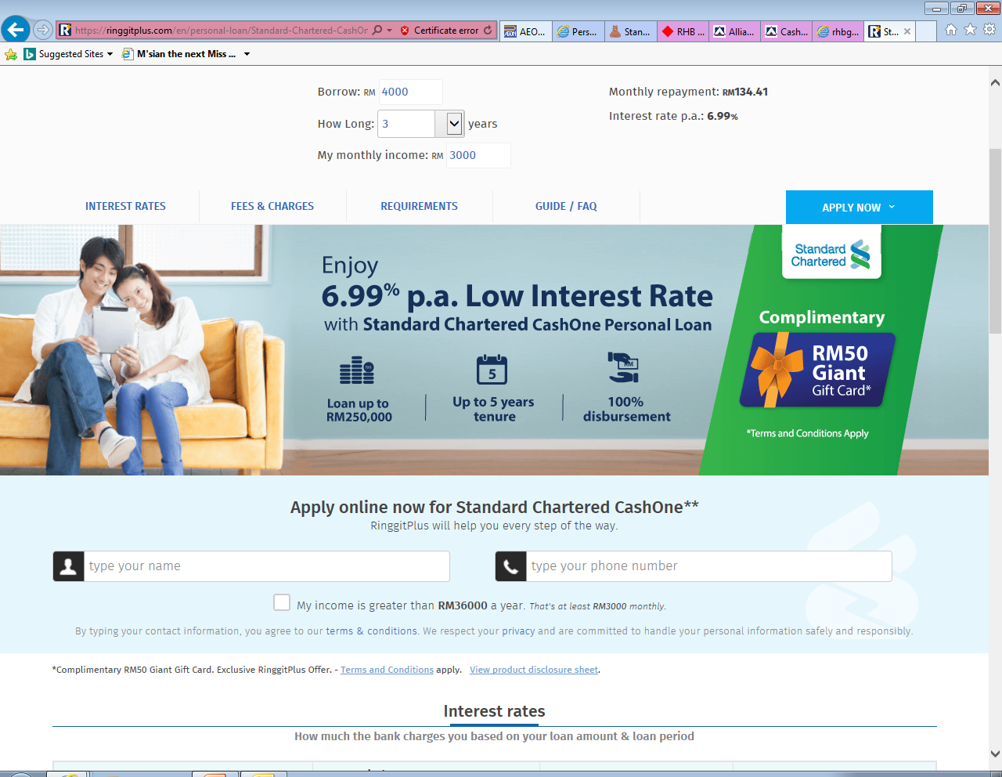
Personal Financing (Risk Category: Market Risk: New & existing campaign)
Campaign | Alliance Bank | Features
Ringgitplus rewards |  | Eligibility: Open to all customers who applied via Ringgit plus website. Min income : RM 3K monthly FA RM5,000 - RM150,000. Tenure : 12- 84 Months Campaign Durations: 5th Dec - 31st Jan 2018 Rewards: RM50 Petrol Voucher for Approved and Successfully disbursed loan exclusively for online application at Ringgit plus website.
 | Standard Chartered
Ringgitplus rewards |  | Eligibility : Open to New to bank customers. Apply for SC CashOne via online and Successfully disbursed. Personal Loan FA: up to 250K, Tenure : 5 years. Campaign Durations: Application 1st Aug 2017 until 24th Mar 2018, Disburse by 30th Apr 2018. Rewards: RM 50 Giant Gift Card

Slide 5


Personal Financing (Risk Category: Market Risk: New & existing campaign)
Campaign | Easy by RHB - Easy Pinjaman Ekspres | Features
Ringgitplus rewards |  | Eligibility: Open to all customers who applied via Ringgit plus website and submit the application at any RHB Easy Branch during the campaign period, and are then subsequently approved and disbursed. Campaign Durations: 20 Dec 2017 - 31 Mar 2018. Rewards: RM21,000 – RM30,000 Get RM200 Giant Voucher RM31,000 – RM150,000 Get RM400 Giant Voucher
 | Citibank
Ringgitplus rewards |  | Eligibility: Apply Personal Loan via online at Ringgitplus website and subsequently approved and disbursed. FA : RM5K- RM150K. Tenure : 2 - 5 years Campaign Durations: 17th July 2018 – 31st Jan 2018. Latest by 28th Feb 2018. Rewards: Philips Portable Speaker

Slide 6
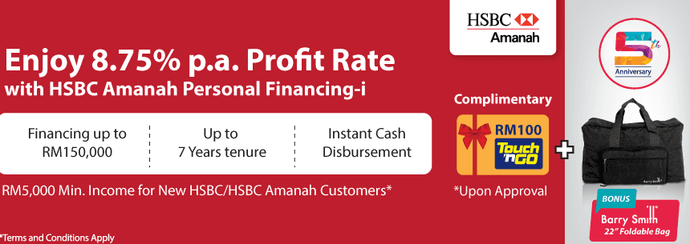
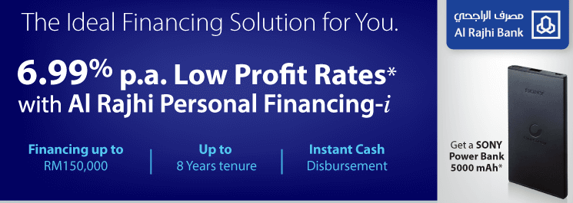
Personal Financing (Risk Category: Market Risk: New & existing campaign)
Campaign | HSBC Amanah Personal Financing - i | Features
Ringgitplus rewards |  | Eligibility: Open to customers apply online via Ringgit plus website and are subsequently approved and receive financing for more than RM20,000. New Customer : Minimum income 5K. Existing Customer : Minimum income 3K. FA RM6,000 - RM150,000, Tenure up to 7 years to entitle for (profit rate) 8.75% p.a. Campaign Durations: 06th June’17 - 31st Jan’ 18. Rewards : FA > 20K Approved & Disbursed : RM100 Touch ‘n Go Card
 | Al Rajhi Personal Financing-I | Features
 |  | Eligibility : Apply Personal Financing via online at Ringgitplus website and subsequently approved and disbursed. Mechanics : Financing amount : RM10,000 –RM150,000. Tenure : 2 -8 years Campaign Period : 18th Sept’17 – 31st Mar 2018. Disbursement by 31st May’18 Rewards : SONY 5000mAh Power Bank.

Slide 7


Personal Financing (Risk Category: Market Risk: New & existing campaign)
Campaign | RHB Personal Financing | Features
Ringgitplus rewards |  | Eligibility : Open to all customers apply online via Ringgit plus website and are subsequently approved and disbursed. FA RM21,000 - RM150,000. Tenure 1-7 years. Campaign Durations : 20th Dec 2017 - 30th Apr 2018. Disbursement by 30th June 2018. Rewards: RM21,000 – RM30,000 Get RM200 Giant Voucher RM31,000 – RM150,000 Get RM400 Giant Voucher
 |  | Eligibility : Open to all customers apply online via Ringgit plus website and are subsequently approved and disbursed. FA RM5,000 – RM250,000. Tenure 2 - 10 years. Campaign Durations : 10th Oct 2017 – 10 Oct 2018, Approved and Successfully disbursed by 31st Nov 2018 Rewards: RM50 Giant Voucher.

Slide 8

Personal Financing (Risk Category: Market Risk: New & existing campaign)
Campaign | JCL | Features
Ringgitplus rewards |  | Eligibility : Open to all customers apply online via Ringgit plus website and are subsequently approved and disbursed by JCL . FA : RM500 – RM 50,000. Tenure : 1 - 5 years. Campaign Durations : 10Aug 2017 – 31st Jan 2018. Approved by JCL by 1st Mar 2018 Rewards: RM30 AEON Voucher

Slide 9
Market Analysis

Slide 10



Personal Financing (Risk Category : Market Risk)
Items
Product Name | Cash First Personal Loan Cash Vantage Financing-i | Personal Financing-i | Personal Financing -i
TAT | 24 hours | 48 hours | Fast approval
Interest Rate | 8.38% p.a. for RM5,000 For 7 years tenure | 9% - 13.5% p.a. | Non Package Personal Financing-i: 6% to 7%p.a. with takaful. 7% to 8% p.a. without takaful. On-package Personal Financing-i: 4.99% p.a.
Tenure | 12 – 84 months | 24 – 84 months | 12 - 120 months
Min Salary | RM3,000 | RM2,000 | Package Personal Financing: RM2,000 Non-package Personal Financing: RM 3,500
Min Installment | RM94 | RM103 | RM883.30
Finance Amount | RM5,000 – RM150,000 | RM5,000 – RM250,000(6 to 9x salary) | Package Personal Financing: RM10,000 – RM200,000 Non-package Personal Financing: RM 10,000 – RM150,000
LPC. | 1% p.a. on overdue amount | 1% p.a. on the amount in arrears | 1% p.a. on overdue installment until date of full payment
Processing Fee | NIL | NIL | NIL
Disbursement | IBG/IBFT | IBG - 3 working days | -
Docs Required | MyKad, Disbursement Account particulars, 1 or 3 months pay slip or Latest 6 months EPF Statement or Form BE / EA. | Mykad, 3 months pay slip, 2 months EPF , B/BE Form & 6 months personal bank statement | MyKad & 3 months pay slip, Latest employers confirmation letter, or latest 3 months Bank Statements of salary crediting account, latest tax income form or EPF statement.

Slide 11



Personal Financing (Risk Category : Market Risk)
Items
Product Name | Maybank Islamic Personal Financing | Easy-Pinjaman Express | Quick Cash Edge
TAT | Fast Approval | 10mins | Fast approval
Interest Rate | 11% p.a. : RM5,000 - RM20,000 10% p.a. : RM20,001 - RM 50,000 9% p.a. : RM50,001 – RM 100,000 | 8.18%p.a. – 13.38%p.a. | 6.996% p.a.
Tenure | 1 - 6 years | 12 – 84 months | 12 – 60 months
Min Salary | RM 2,500 | RM1,500 | RM 2000
Min Installment | RM115.28 | RM57.54 | -
Finance Amount | RM5,000 – RM100,000 | RM2,000 – RM150,000 | RM4000 - RM250,000
LPC. | 1% p.a. on the amount in arrears | 1% of overdue amount | 1% of overdue amount
Processing Fee | N/A | N/A | N/A
Disbursement | - | 10mins after approval | 1day after approval
Docs Required | MyKad, Latest 2 months salary slips and Latest 6 months Account Statement or Latest BE form with official tax receipt and Business Registration | MyKad , Salary Slip, EPF Statement & Bank Statement | MyKad, 1month pay slip & Bank Statement, EPF statement or BE form

Slide 12


Personal Financing (Risk Category : Market Risk)
Items
Product Name | Personal Financing-i | Personal Loan - AmMoneyLine | Maybank Personal Loan
TAT | 14 days | 48 hours | 10mins
Interest Rate | Fixed profit rate at 6.99% p.a. | 8.0% p.a. to 11.99% p.a. | 8% p.a. : RM5K - RM20K 7% p.a. : RM20K - RM50K 6.5% p.a. : RM50K - RM100K
Tenure | 12 - 60 months | 12 – 60 months | 24 - 72 months
Min Salary | RM1,000 | RM2,000 | RM2,500
Min Installment | - | RM104 | RM102.78
Finance Amount | RM4,000 - RM250,000 | RM2,000 – RM100,000 | RM5,000 – RM100,000
LPC | 1% p.a. of overdue installment | 1% p.a. of overdue installment | 1% p.a. of overdue amount
Processing Fee | NIL | NIL | NIL
Disbursement | - | - | 10mins after approval
Docs Required | MyKad, 3 months pay slip, bank statement & Form J/EA/EC | MyKad, 3 months pay slip & 3 months bank statements or latest EPF statement | MyKad, latest BE form with official tax receipt, 3 months pay slip, & 6 months bank statement

Slide 13


Personal Financing (Risk Category : Market Risk)
Items
Product Name | Xpress Cash Financing-i | Cash Plus Personal Loan | Personal Financing-i
TAT | 24 hrs | 24 hrs | -
Interest Rate | 18% - 24% p.a. | Salaried, RM50,000-RM100,000: 8.2% p.a. Salaried, RM20,000-RM49,900: 10.88% p.a. Salaried, RM2,000-RM19,900: 14.66% p.a. Self Employed, RM2,000-RM100,000: 14.66% | 4.3% p.a. : Biro Perkhidmatan Angkasa 6.9% p.a. : Selected private and government-linked companies
Tenure | 6 – 60 months | 12 – 60 months | 24 – 48 months
Min Salary | RM800 | RM2,000 | RM1,500
Min Installment | RM110 | RM58 | RM 122.08
Finance Amount | RM3,000 – RM50,000 or up to 8x gross income | RM3,000 – RM100,000 | RM5,000 – RM200,000
LPC | 1% of overdue installment | 1% of overdue amount | 1% p.a. of overdue installment
Processing Fee | NIL | NIL | Yes
Disbursement | Fast disbursement | Fast disbursement | N/A
Docs Required | MyKad, 3 months pay slip, Bank Statement & EPF Statement | MyKad, 3 months pay slip, Bank Statement & EPF Statement | MyKad, 1 month pay slip & one copy of Saving Account Passbook or Current Account statement

Slide 14

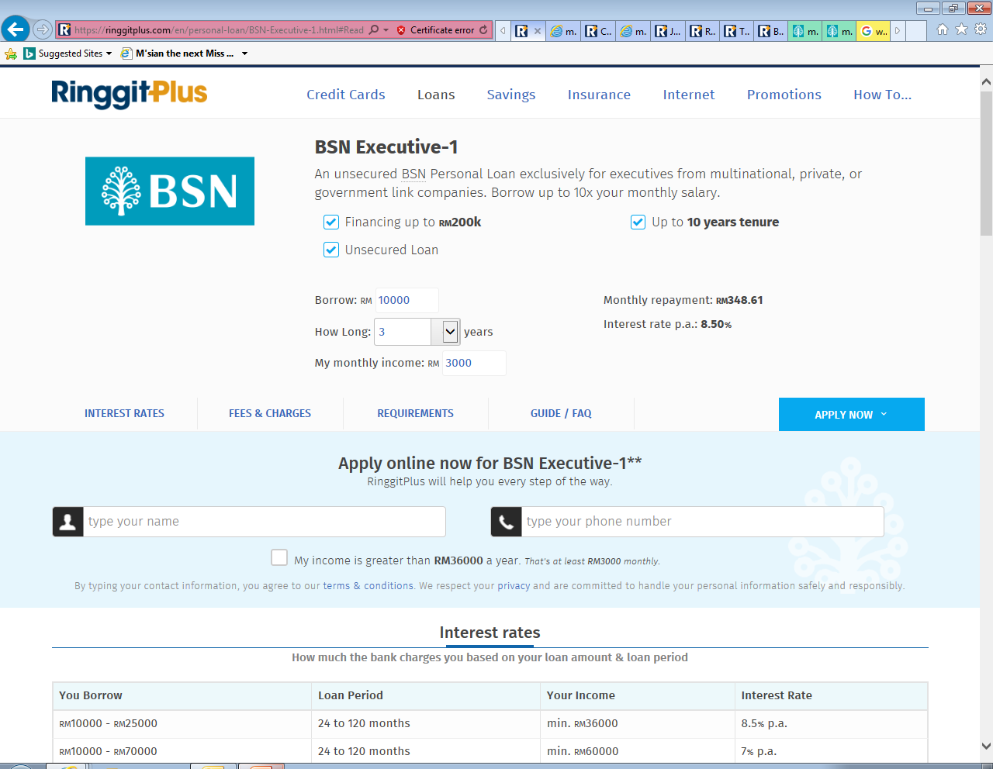

Personal Financing (Risk Category : Market Risk)
Items
Product Name | Personal Financing-i | BSN Executive-1 | Personal Financing-i
TAT | 48 hours | - | Fast Approval
Interest Rate | 7.5%p.a. | 6.00% p.a. – 8.50% p.a. | 12.5% p.a. : RM6K – RM19.5K 11.5% p.a. : RM20K – RM49.5K 10.5% p.a. : RM50K – RM150K
Tenure | 12 – 60 months | 2 yrs - 10 yrs | 24 – 84 months
Min Salary | RM2,000 | RM3,000 | RM3,000
Min Installment | RM90.77 | RM231.25 | RM134
Finance Amount | RM5,000 – RM150,000 (up to 5x salary) | RM10,000 – RM200,000 | RM6,000 – RM150,000
LPC. | 1% p.a. of overdue amount | 1% p.a. of overdue installment | -
Processing Fee | Yes | N/A | NIL
Disbursement | 1% p.a. on overdue amount | N/A | Instant Cash disbursement
Docs Required | 3 months pay slip, BE Form, letter of employment, 6 months EPF & 3 months bank statements | MyKad, 3 months pay slip, latest EPF statement & confirmation letter by employer | MyKad, 3 months pay slip & Form BE

Slide 15

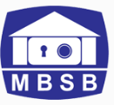
Personal Financing (Risk Category : Market Risk)
Items
Product Name | Personal Financing-i Private Sector | MBSB Personal Financing Mumtaz-i | MBSB Personal Financing Afdhal-i | MBSB Personal Financing-i Private Sector
TAT | - | Fast approval | Fast Approval | Fast Approval
Interest Rate | 4.95% p.a. – 9.37% p.a. | 3.66% p.a. | 4.40% p.a. | 6.43% p.a.
Tenure | 12-120 months | 24 – 120 months | 24 – 120 months | 24 -120 months
Min Salary | RM 2,000 | RM2,000 | RM15,000 | RM1,000
Min Installment | - | RM569 | RM600 | RM685
Finance Amount | RM5,000 – RM150,000(up to 25x monthly gross income) | RM50,000 – RM250,000 | RM50,000 – RM400,000 | RM50,000 - RM300,000
LPC. | 1% p.a. of overdue amount | 1% p.a. of overdue installment | 1% p.a. of overdue installment | 1% p.a. of overdue installment
Processing Fee | N/A | Yes | Yes | Yes
Disbursement | N/A | N/A | N/A | N/A
Docs Required | Mykad, 3 months pay slip, 3 months bank statements, EPF and Confirm Letter or EA | MyKad, 3 months pay slip, bank account statement | MyKad, 3 months pay slip, bank account statement | MyKad, 3 months pay slip, bank account statement

Slide 16


Personal Financing (Risk Category : Market Risk)
Items
Product Name | AEON i-Cash | I.O.U Personal Loan | Personal Financing-i Public Sector
Tenure | 7 years | 2-5 years | 1-10 years
Interest Rate | 10.08% - 18% p.a. | 12% p.a. | 3.26% p.a. – 6.53% p.a.
Age | 18 - 65 | 21-60 | 18-60
Approval | 2-3 days | 1 hour | -
Financial Amount | RM 1,000 – RM100,000 | RM5,000 – RM250,000 | RM5,000 – RM200,000
Min Salary | RM 800 | RM2,000 | RM1,000
Loan RM5K @ 5 years | RM 125 | RM 135 | Floating rate: RM 101 Fixed rate: RM 105
Flexible Repayment | No | No | No
Reward | Yes – On tactical Campaign | 20% Cash Back when make prompt monthly repayments | None
Customer Advantage | No fee on early settlement | Up to RM50,000 approve & disburse in 1 hour | Opt for a fixed or floating interest rate based on the Base Rate (BR)

Slide 17




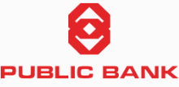
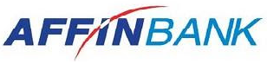
Personal Financing Market Risk
Bank | Product | Interest Rate | Minimum Income | Loan Amount | Max Loan Tenure
 | Citi Bank Personal Loans | 7.9 % p.a. | RM 4,000 | RM5,000 –RM150,000 (up to 8x gross income) | 5 years
 | RHB Personal Finance-i for civil sector | 8.18%p.a. – 15.33% p.a. | RM 2,000 | RM2,000 –RM150,000 | 10 years
 | CashVantage Personal Financing-i | 8.38%p.a. | RM 3,000 | RM5,000 –RM150,000 | 7 years
 | UOB Personal Loan | 9.99%p.a. – 11.99% p.a. | RM 2,000 | RM5,000 – RM100,000 | 5 years
 | Al-Rajhi Personal Financing- i | 6.99% p.a. | RM 5000 | RM5,000 – RM150,000 | 8 years
 | BAE Personal Financing-I (for | 4.88% p.a. | RM 1,500 | RM5,000 – RM150,000 | 10 years
 | Affin Islamic Personal Financing-i | 4.4% p.a. – 5.5 % p.a. | RM2,500 | RM5,000 – RM150,000 | 7 years

